Slide 1
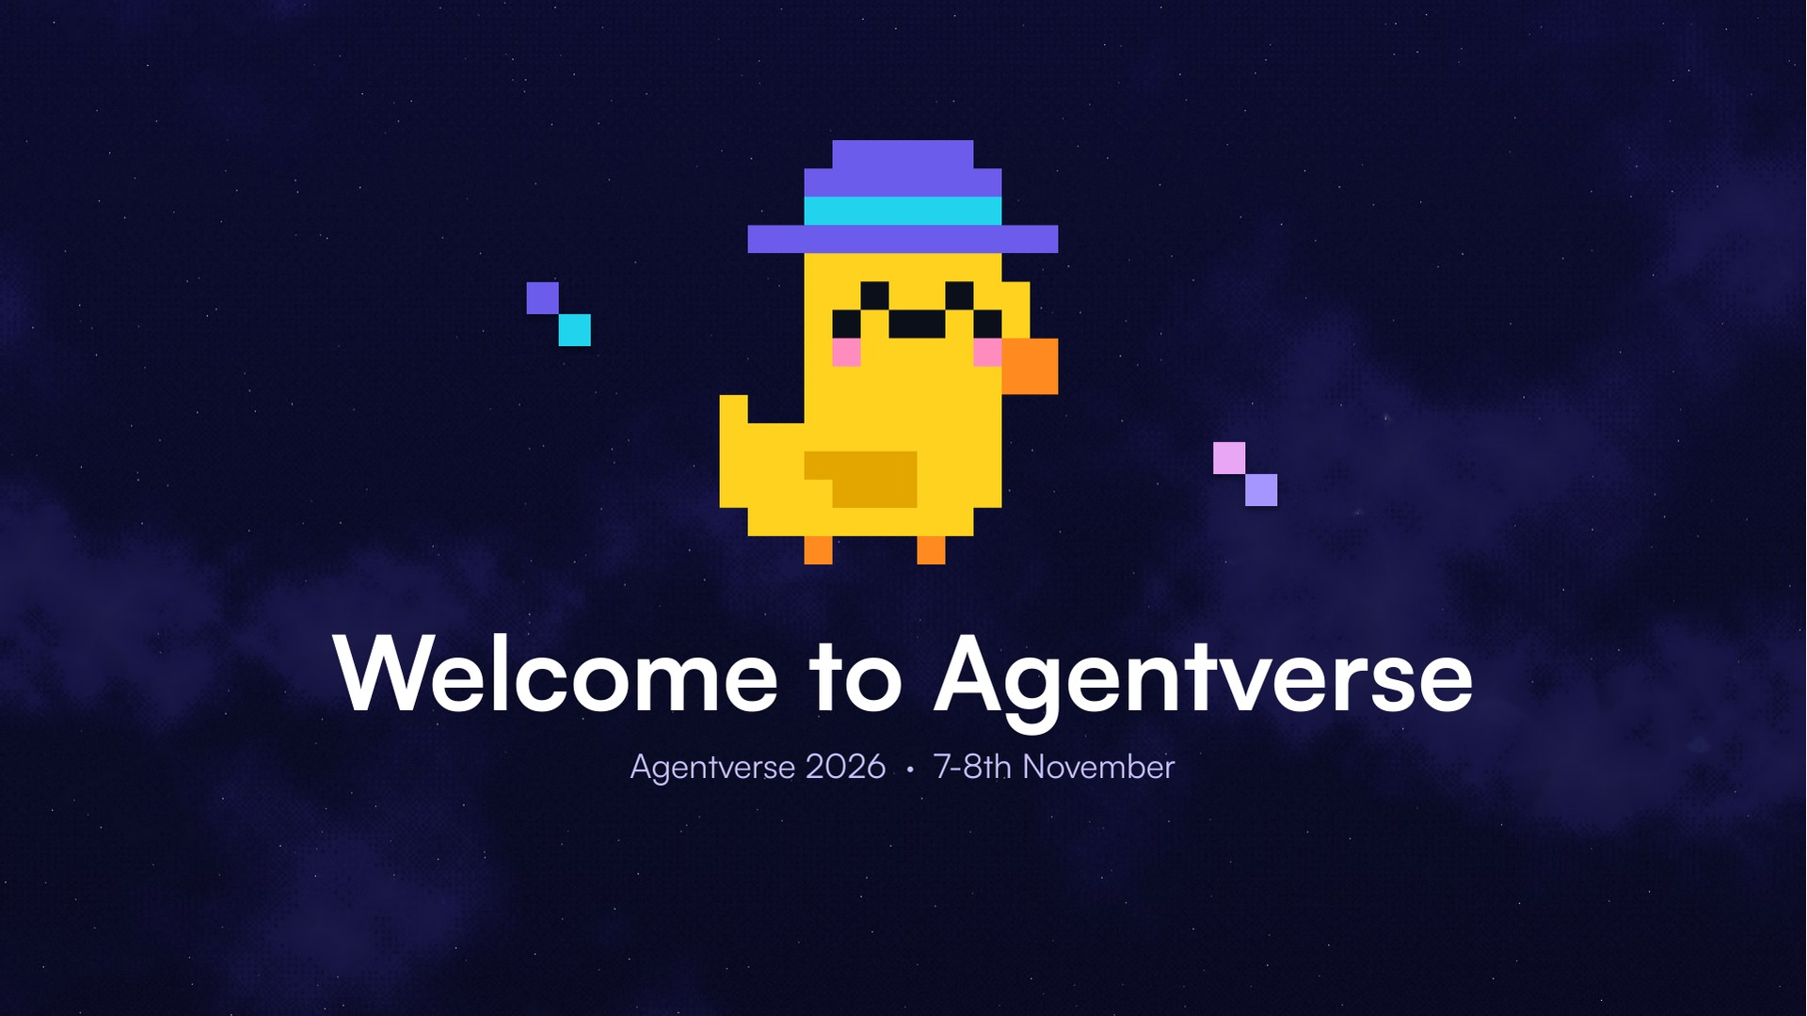
Notes:
Welcome to Agentverse.

Slide 2
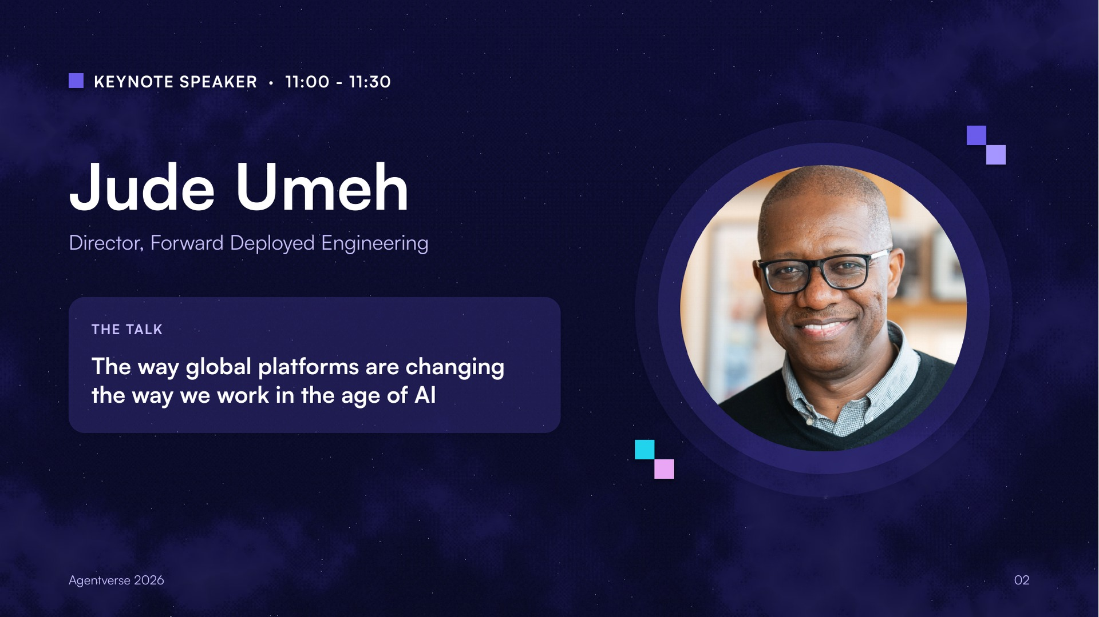
Notes:
Keynote speaker session 1. Jude Umeh: The way global platforms are changing the way we work in the age of AI.

Slide 3
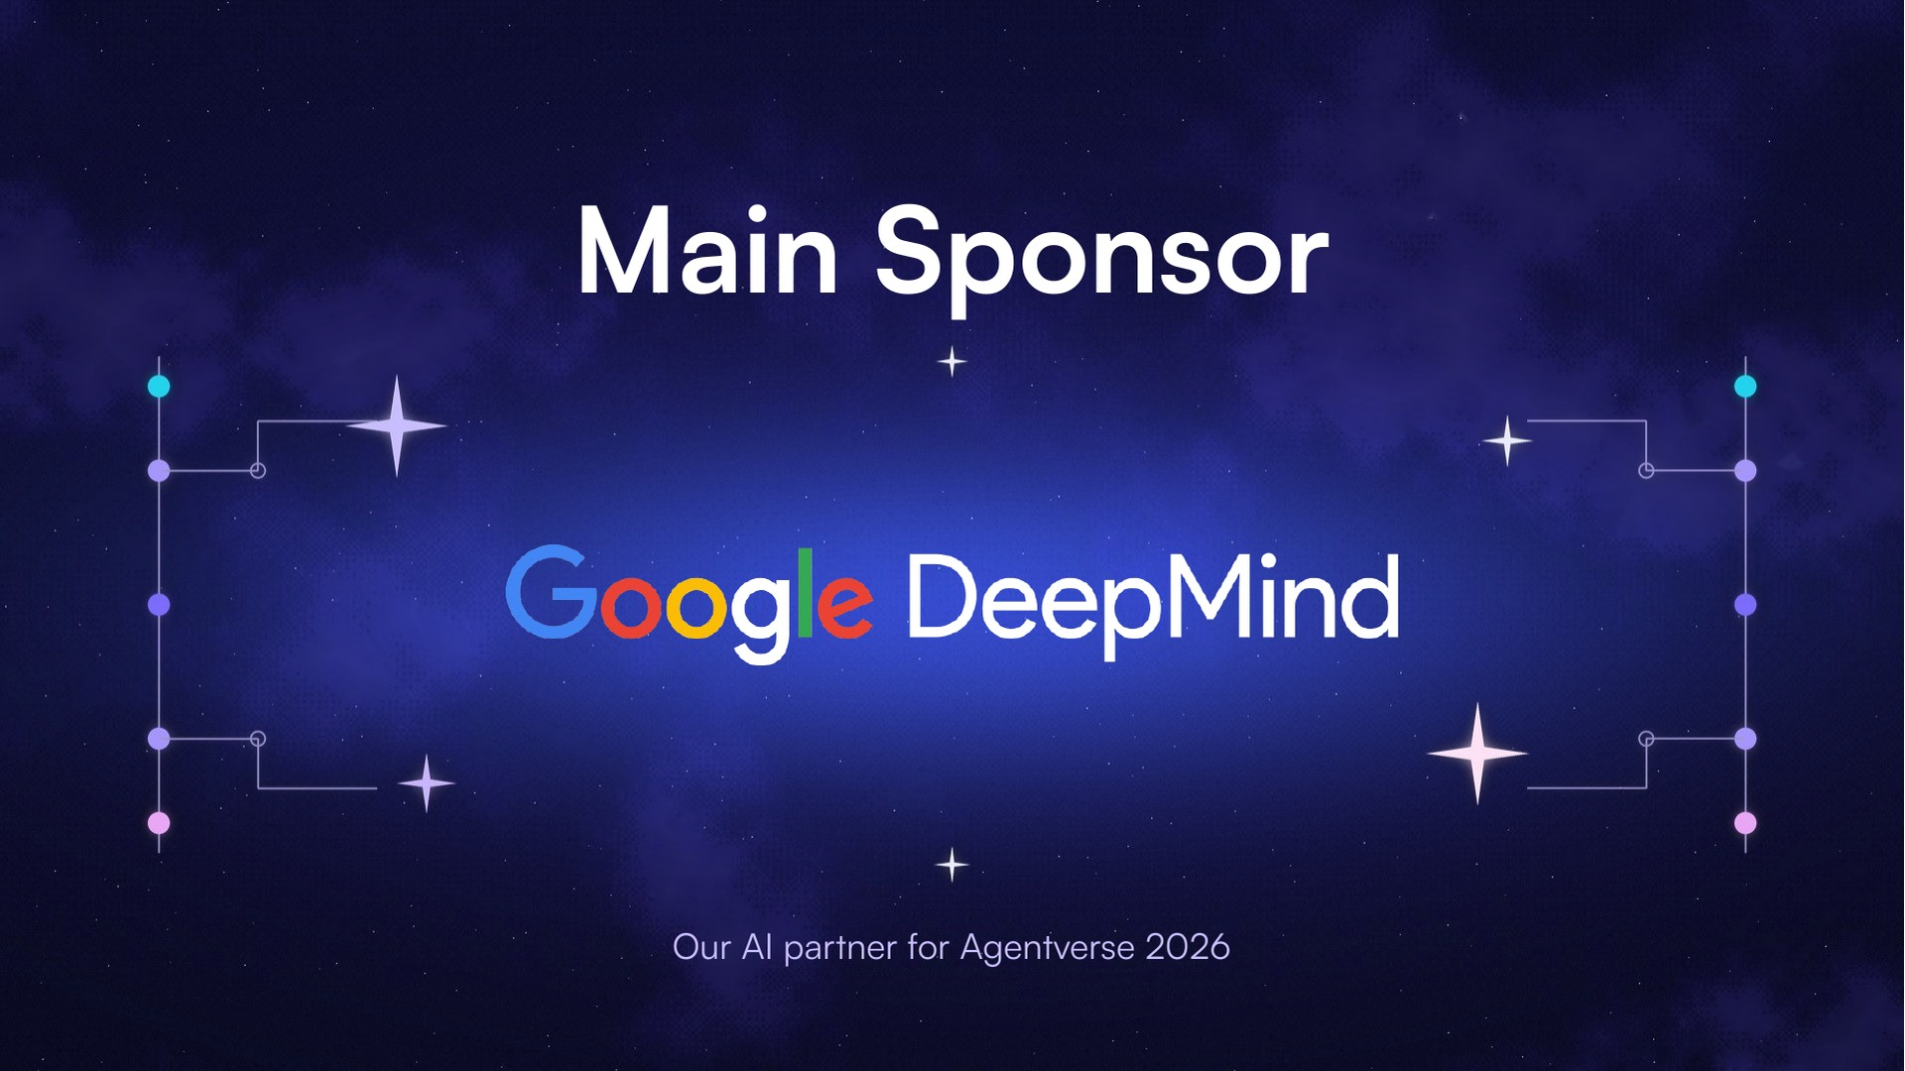
Notes:
Meet our main sponsor, Google DeepMind. Our AI partner for AgentVerse 2026.

Slide 4
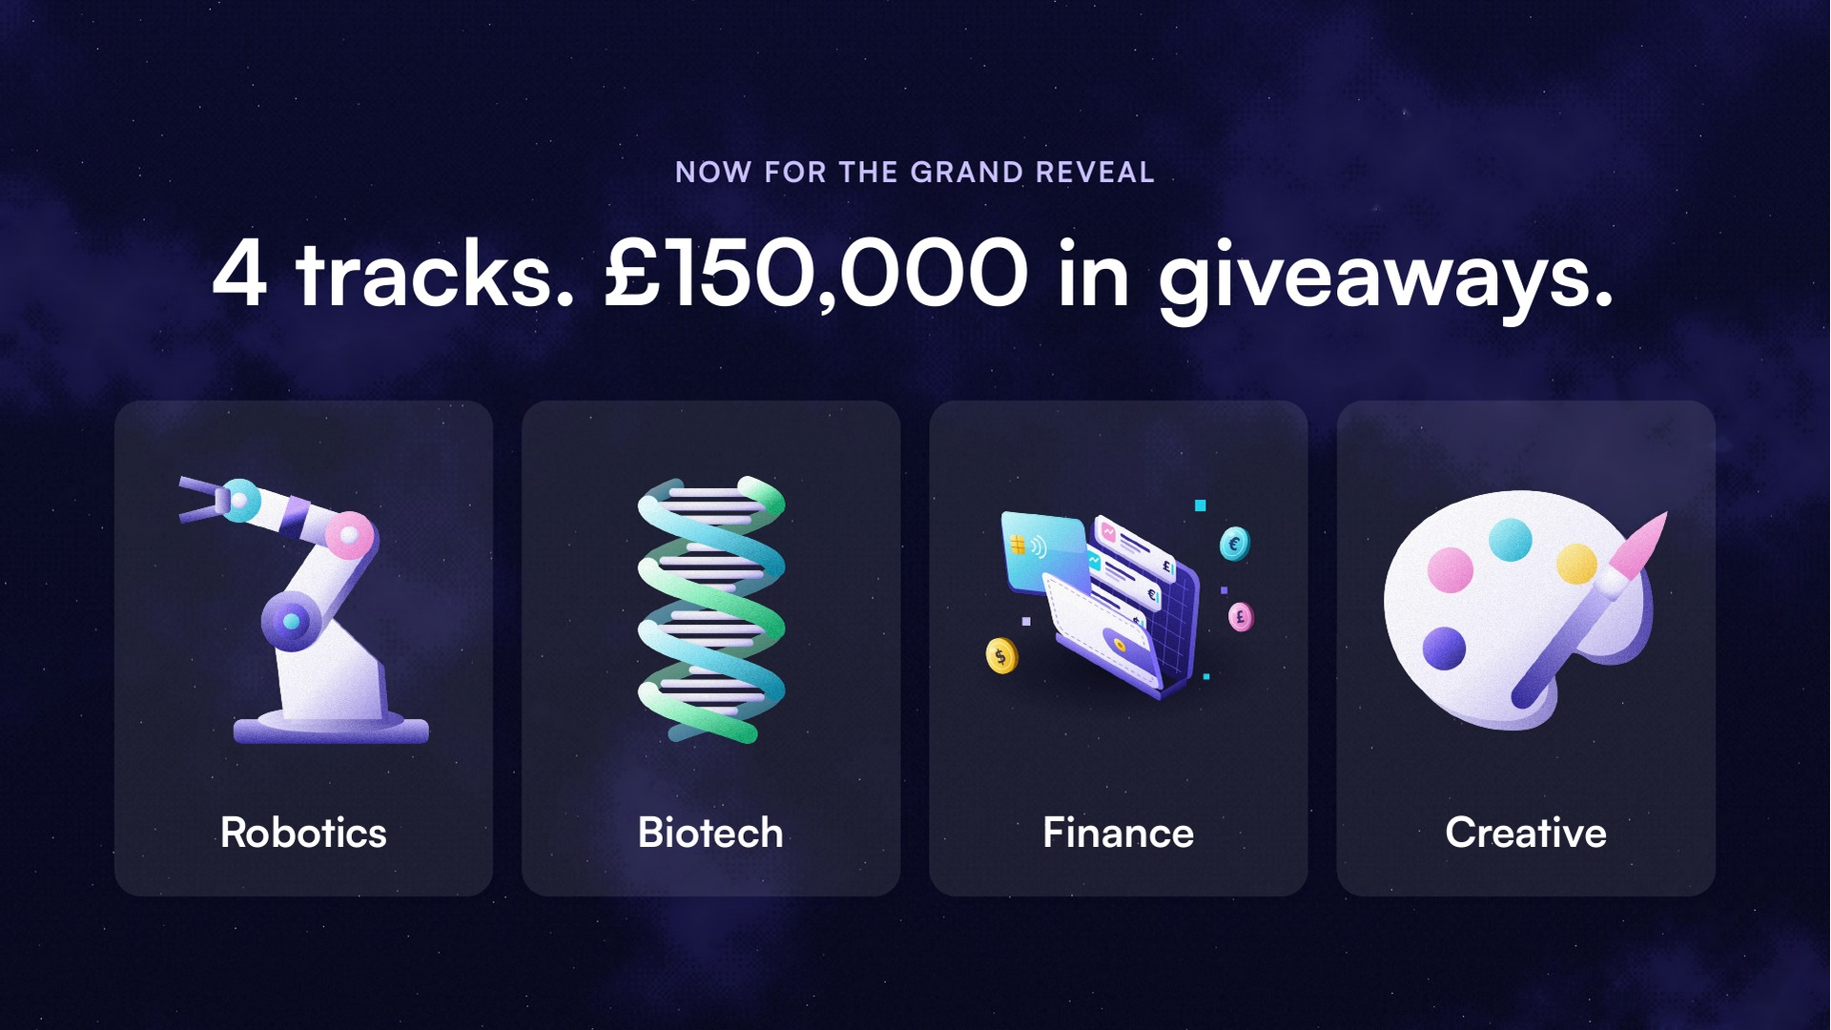
Notes:
Four tracks and £150,000 in giveaways.

Slide 5
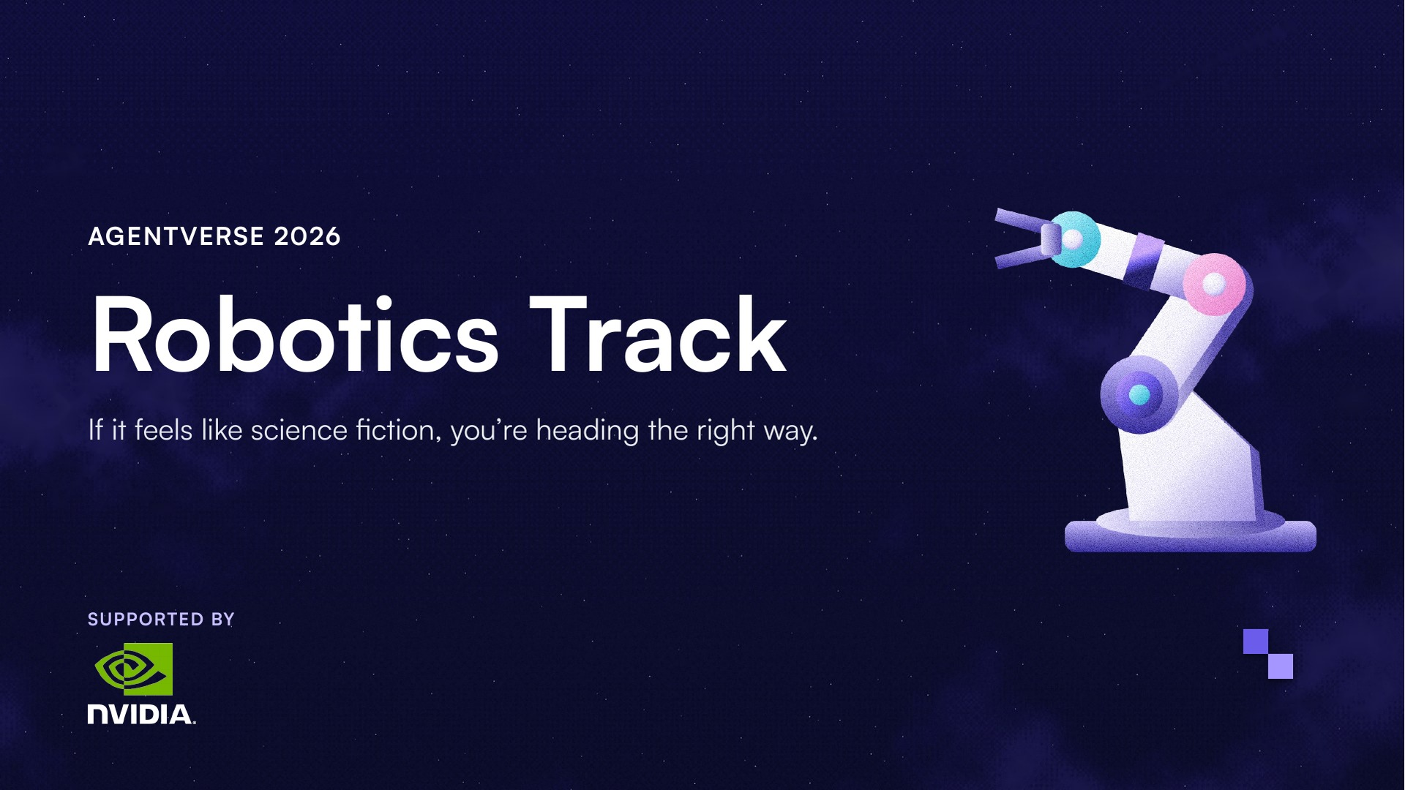
Notes:
Robotics Track, supported by NVIDIA.

Slide 6
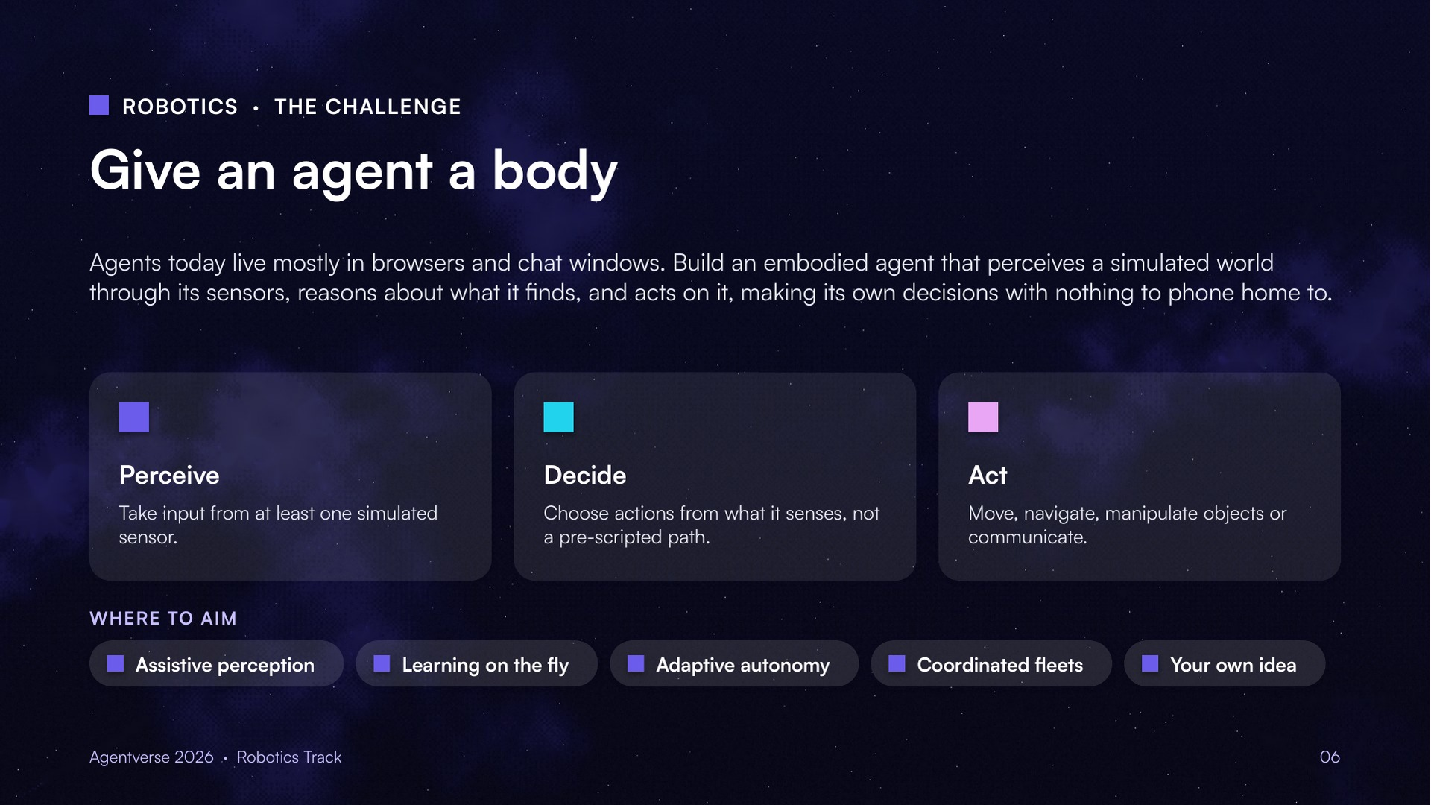
Notes:
Build an embodied agent that perceives a simulated world, reasons about it and acts on it.

Slide 7
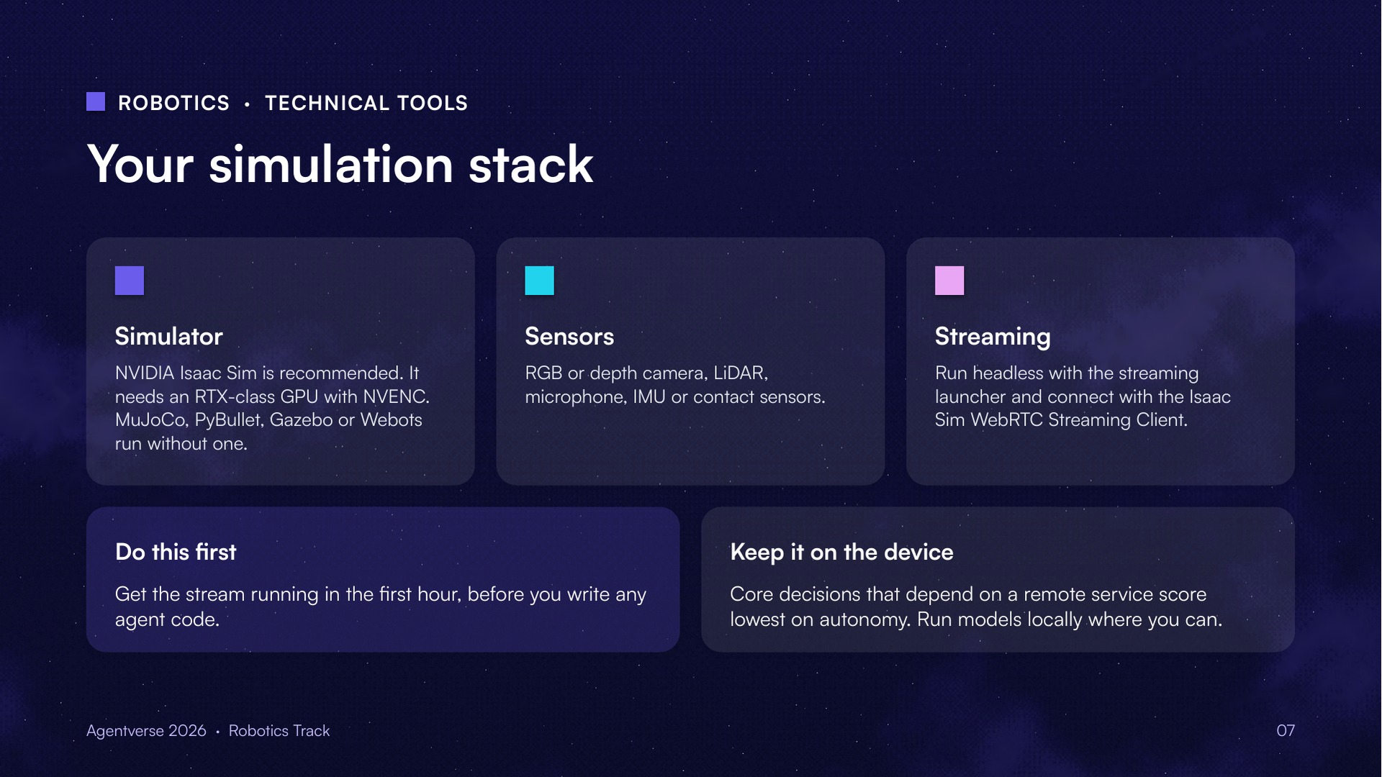
Notes:
Isaac Sim recommended; MuJoCo, PyBullet, Gazebo or Webots also work. Open TCP 49100 and UDP 47998 for remote streaming, restricted to your IP.

Slide 8
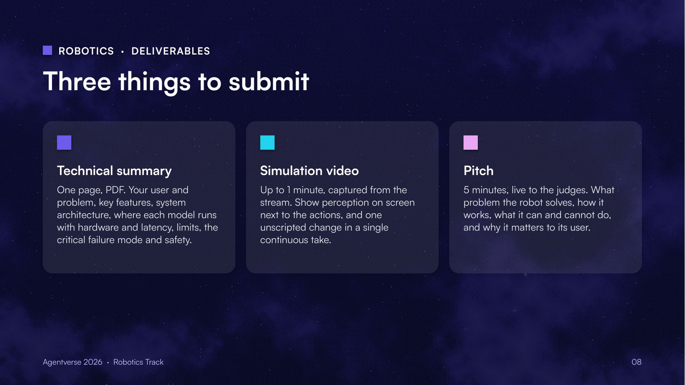
Notes:
One-page technical summary, a simulation video of up to one minute, and a five minute live pitch.

Slide 9
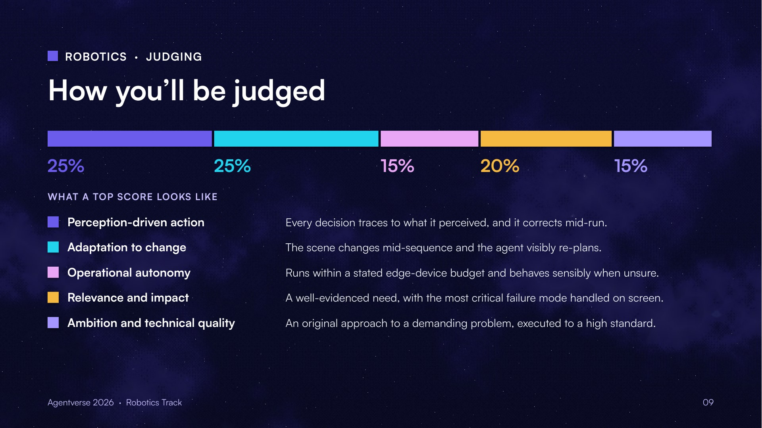
Notes:
Weights: 25, 25, 15, 20, 15.

Slide 10
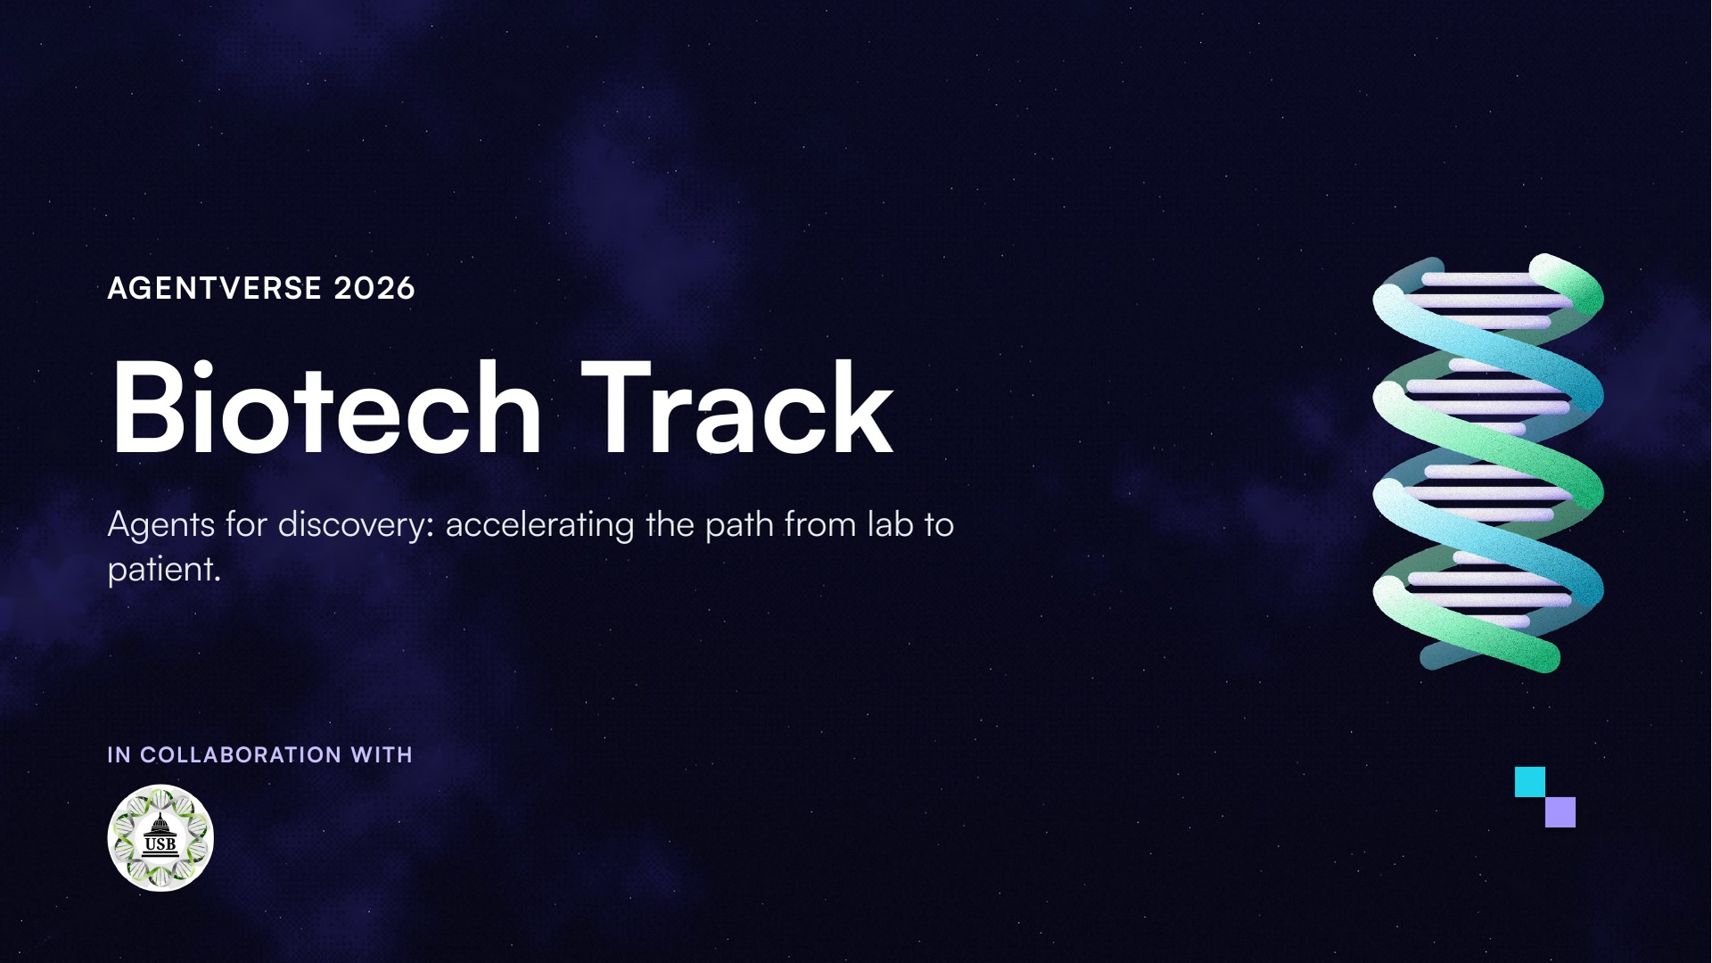
Notes:
Biotech Track, in collaboration with UCL Biotech Society.

Slide 11
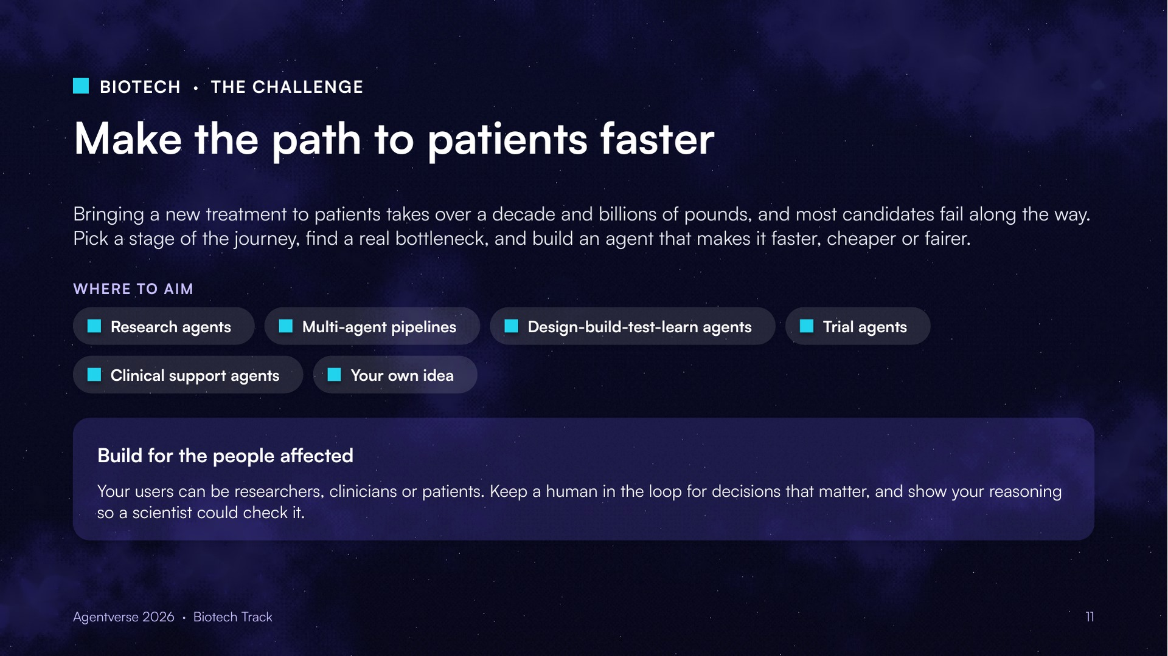
Notes:
Pick a stage of the journey, find a real bottleneck, and build an agent that makes it faster, cheaper or fairer.

Slide 12
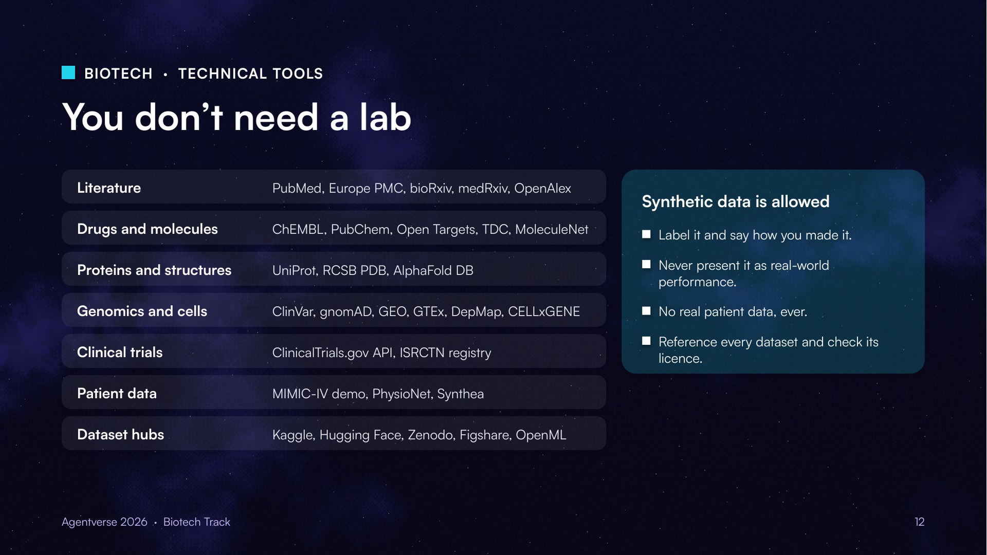
Notes:
Open datasets and synthetic data rules.

Slide 13
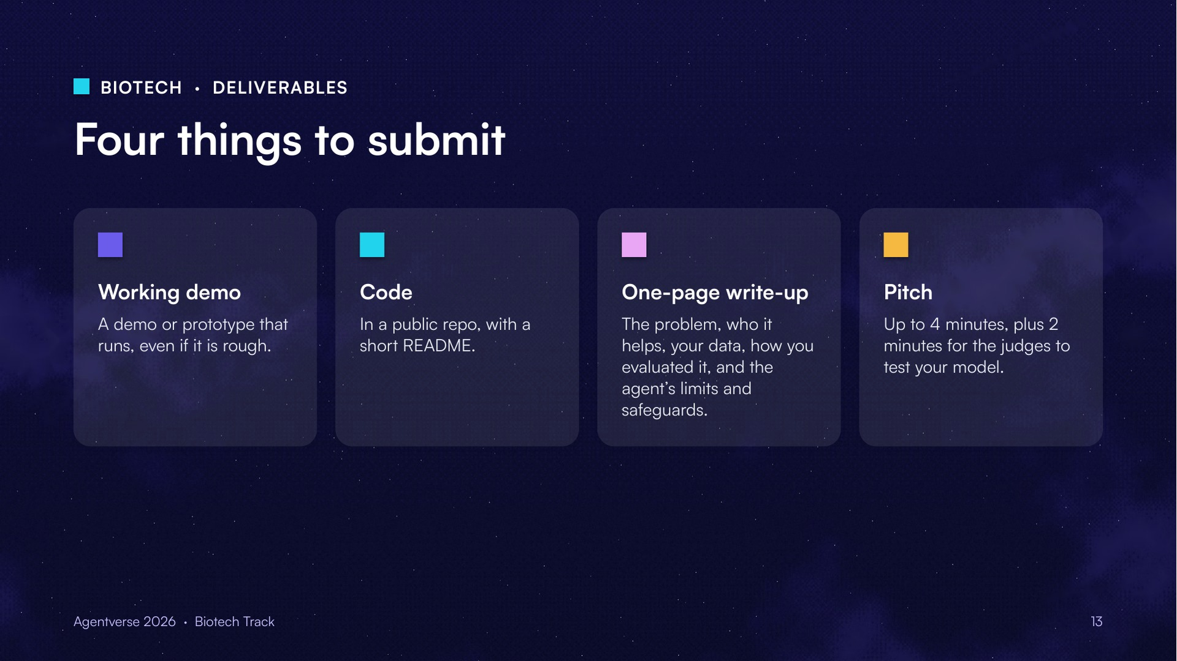
Notes:
Working demo, public code, one-page write-up and a pitch.

Slide 14
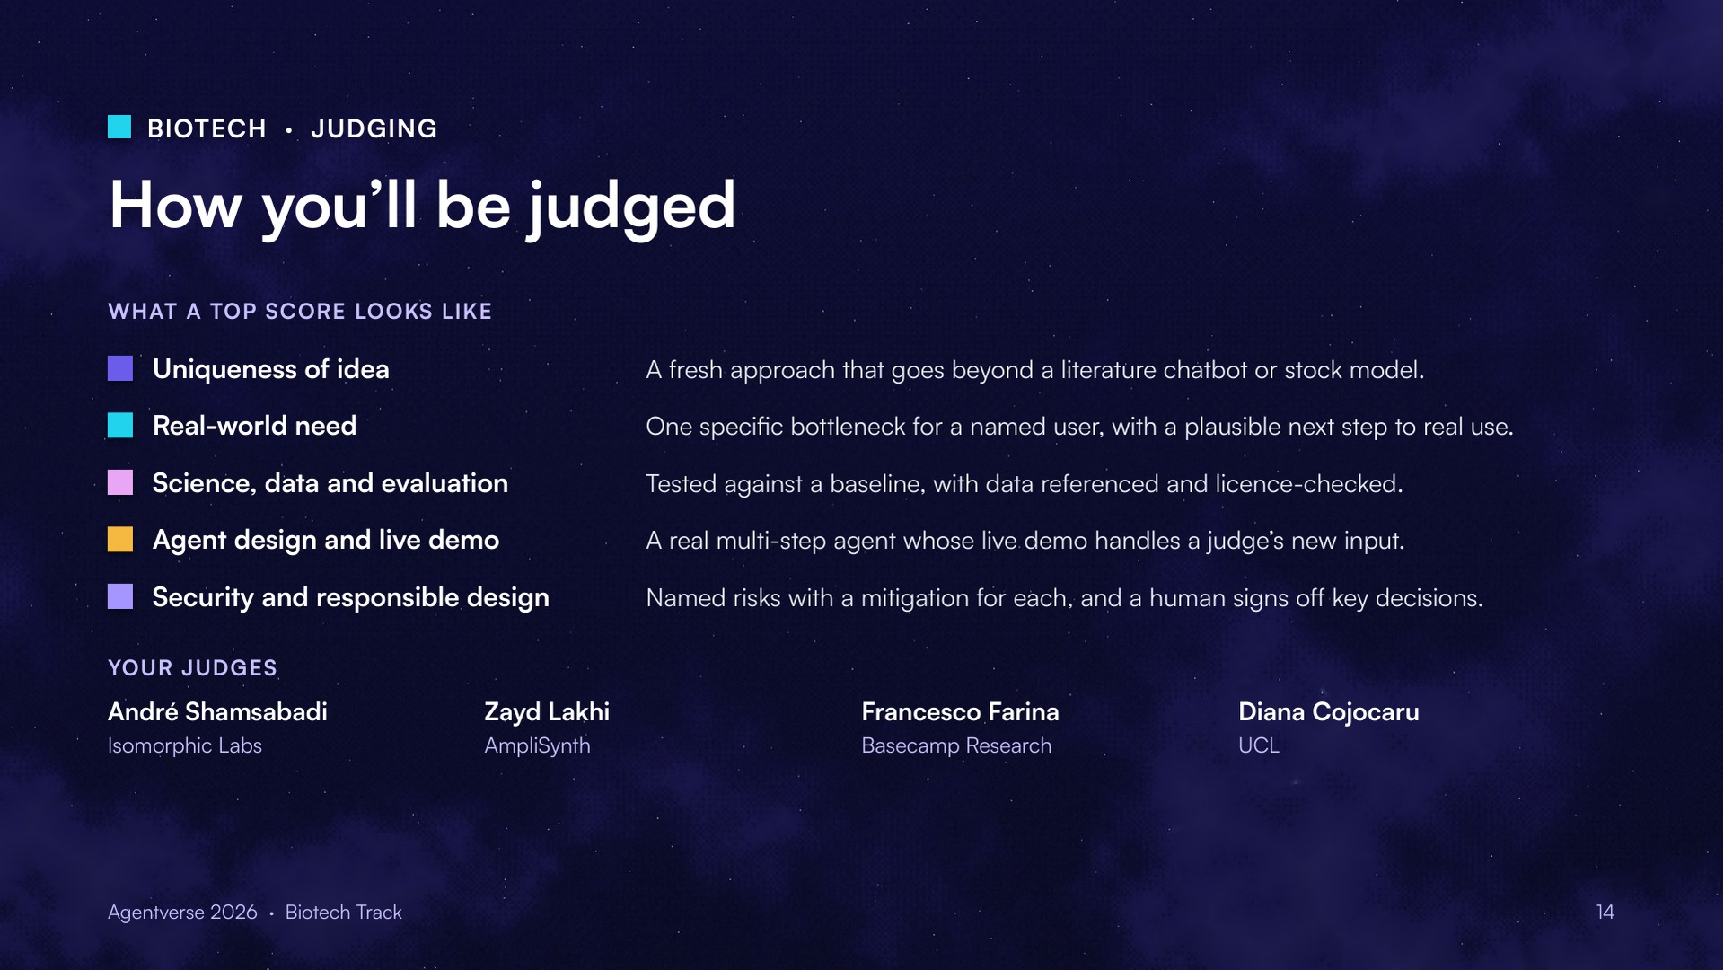
Notes:
Judges: André Shamsabadi (Isomorphic Labs), Zayd Lakhi (AmpliSynth), Francesco Farina (Basecamp Research), Diana Cojocaru (UCL).

Slide 15
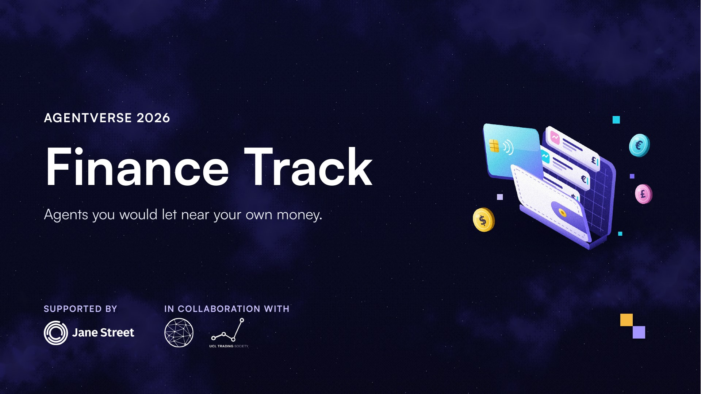
Notes:
Finance Track, supported by Jane Street, in collaboration with UCL Data Science Society and UCL Trading Society.

Slide 16
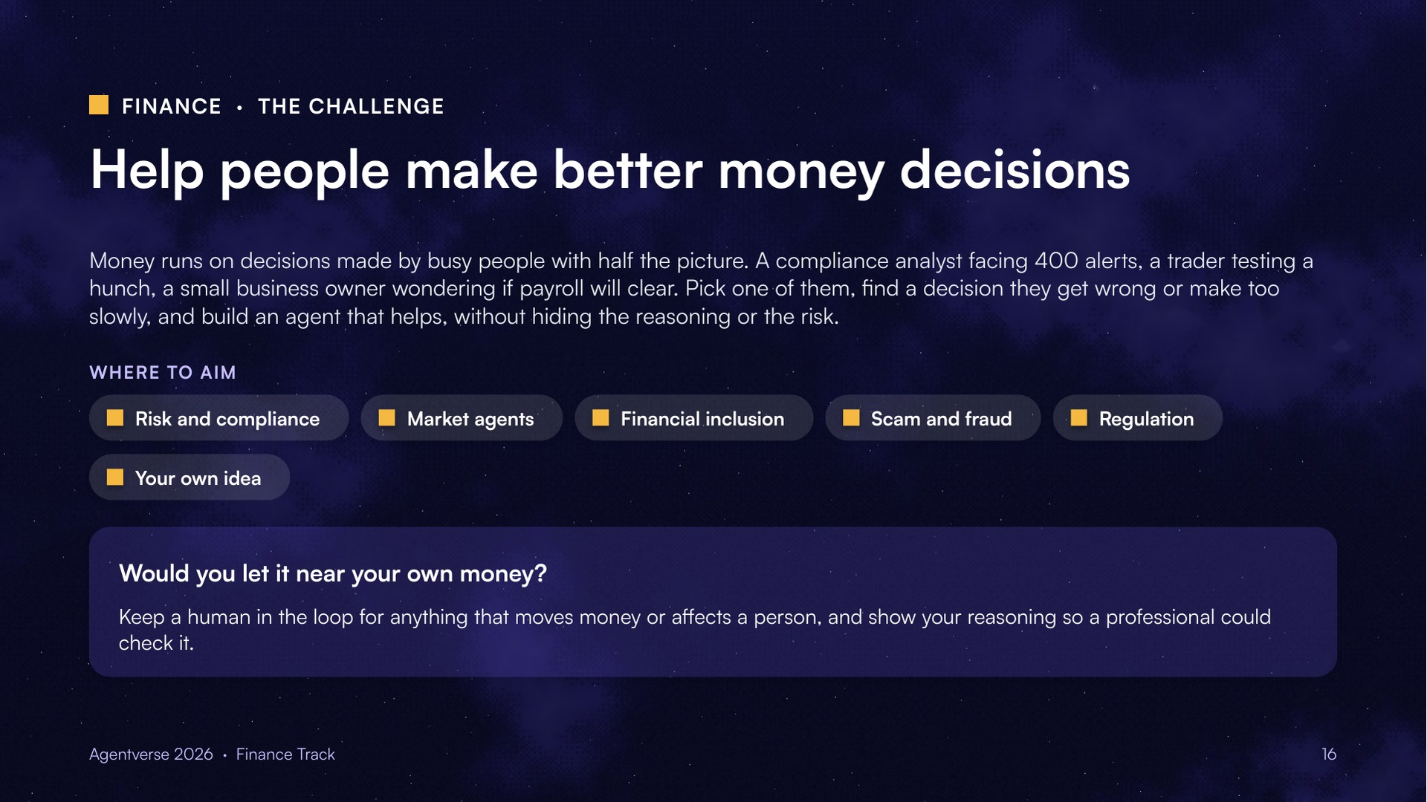
Notes:
Pick one person who runs, regulates or relies on a financial system, find a decision they get wrong or make too slowly, and build an agent that helps.

Slide 17
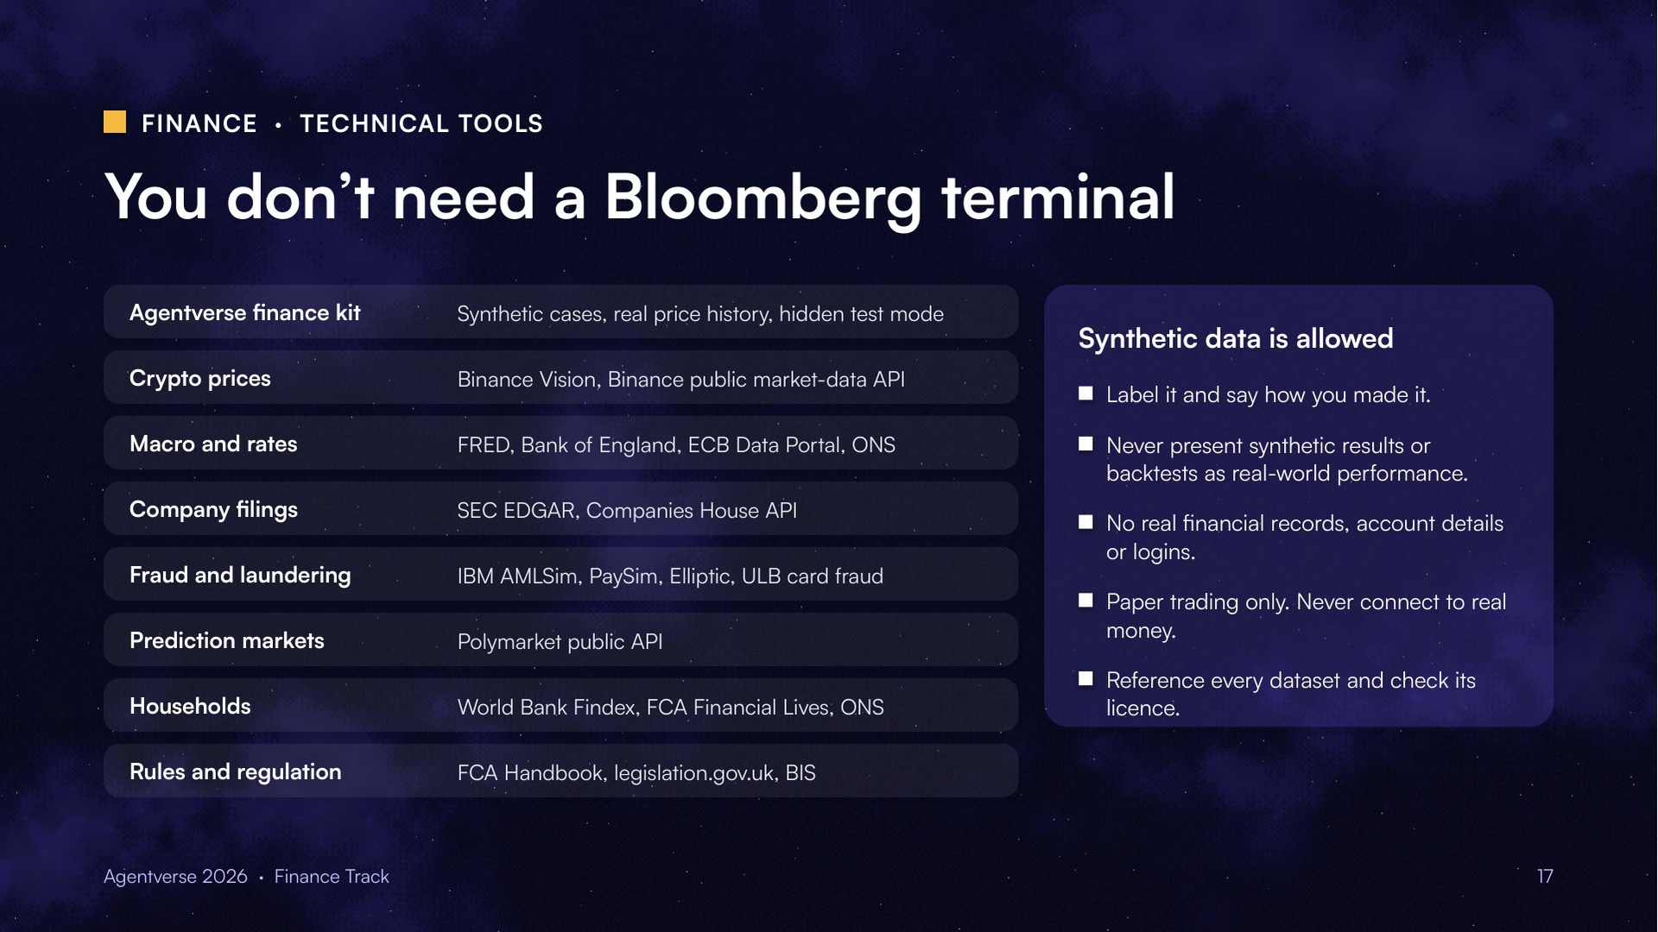
Notes:
Also useful: Kaggle, Hugging Face Datasets, Zenodo, Google Dataset Search, and GDELT for news events. Some free market data is non-commercial only, e.g. Binance Vision is CC BY-NC-SA.

Slide 18
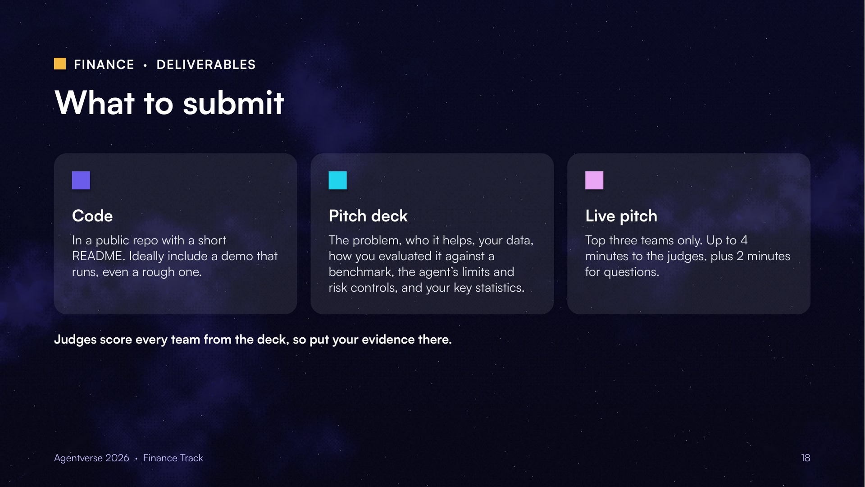
Notes:
Judges score every team from the repo and deck first. Only the three highest-scoring teams pitch live.

Slide 19
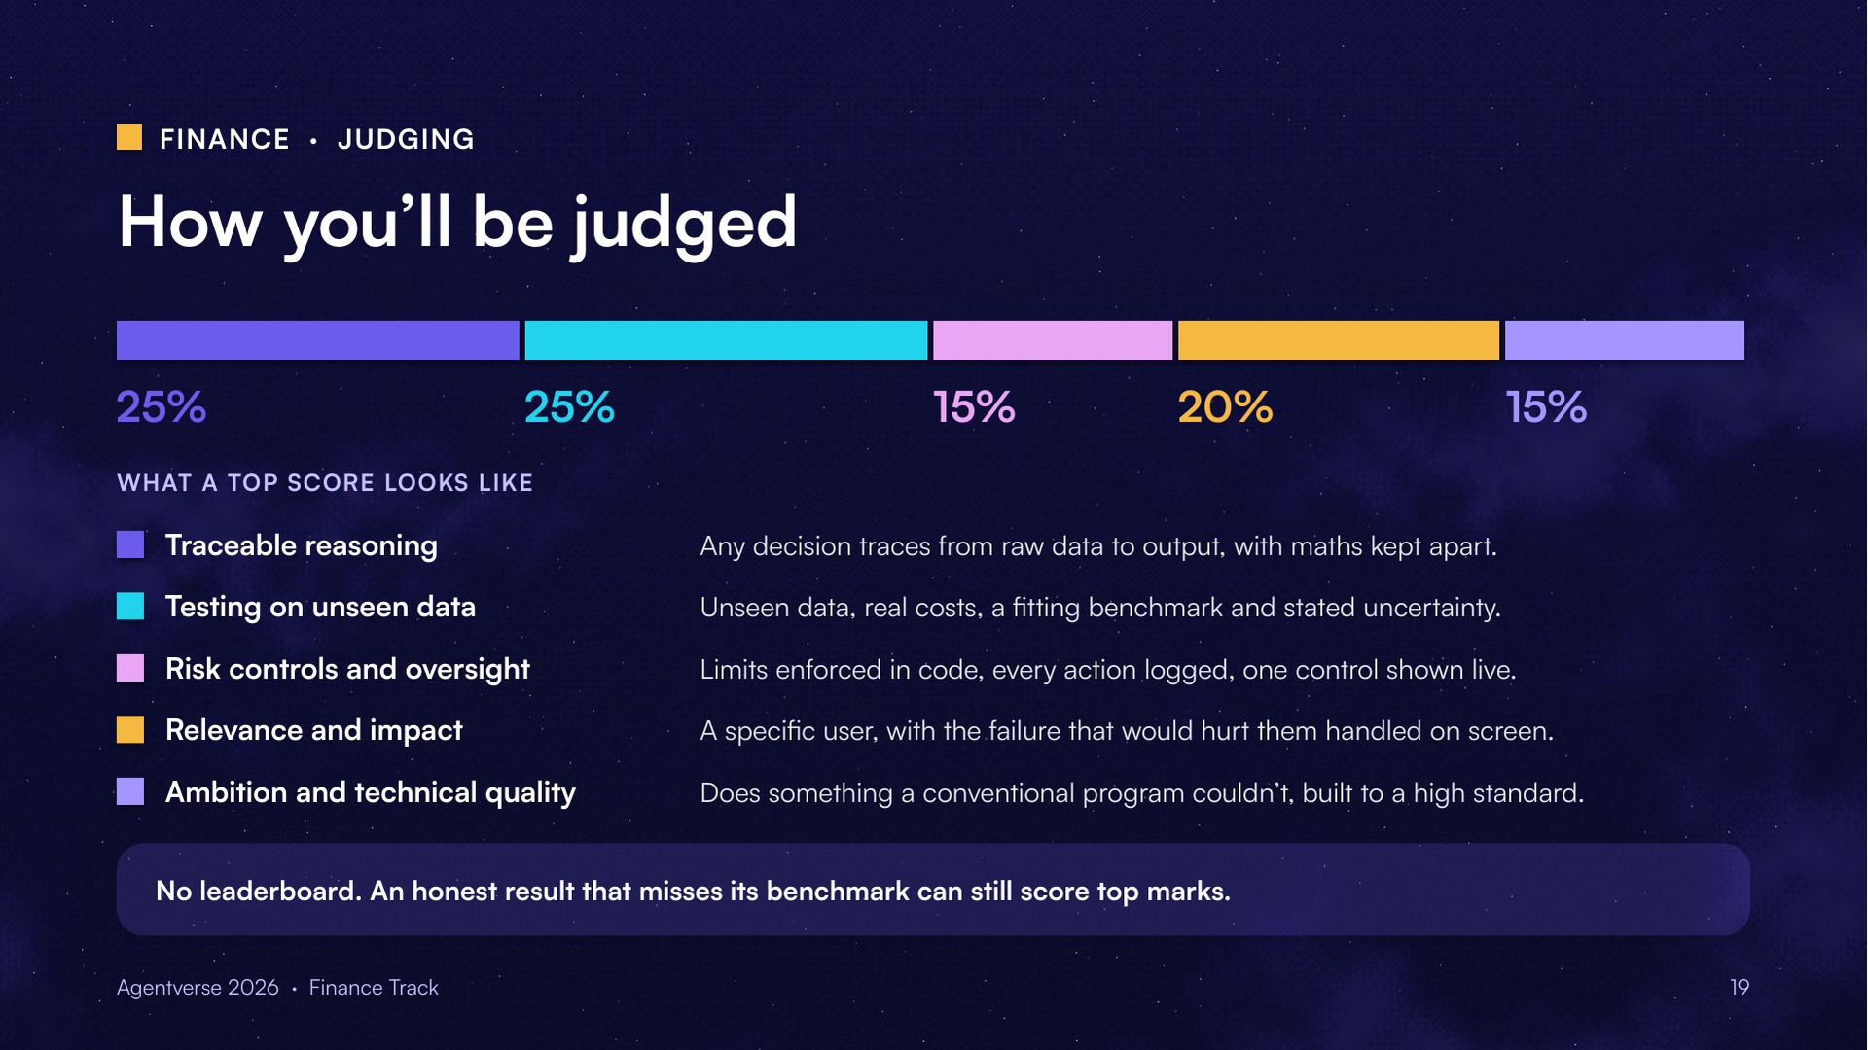
Notes:
Rigour beats a big number. Pick a benchmark that fits: buy-and-hold for directional trading, cash for market-neutral, a simple rule-based check for fraud flags. Controls should match the stakes.

Slide 20
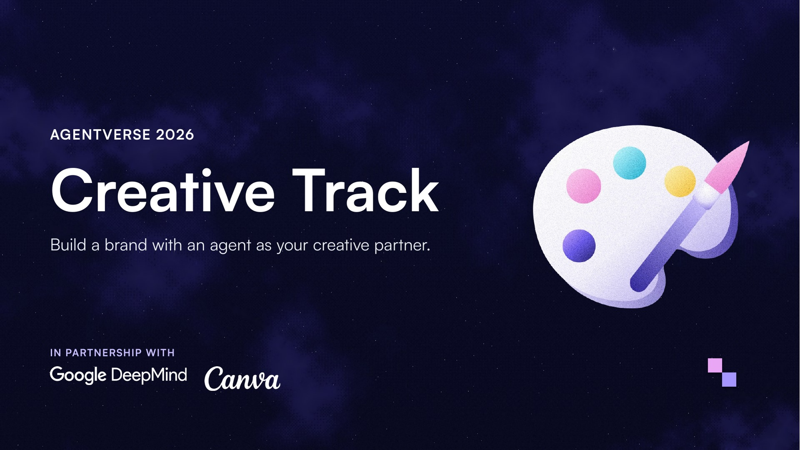
Notes:
Creative Track, in partnership with Google DeepMind and Canva.

Slide 21
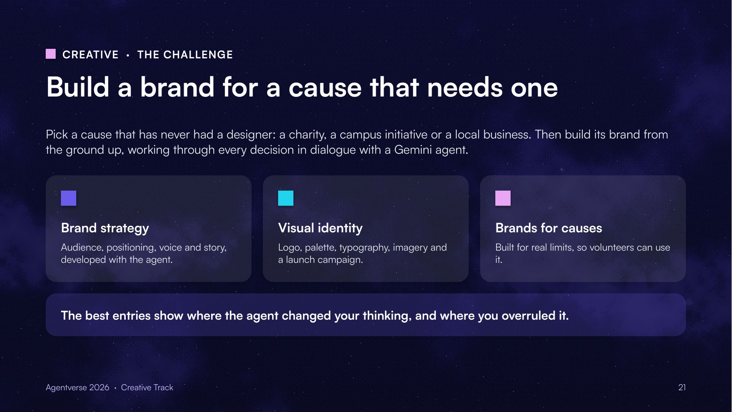
Notes:
Build a brand for a cause that has never had a designer, with Gemini as your creative partner.

Slide 22
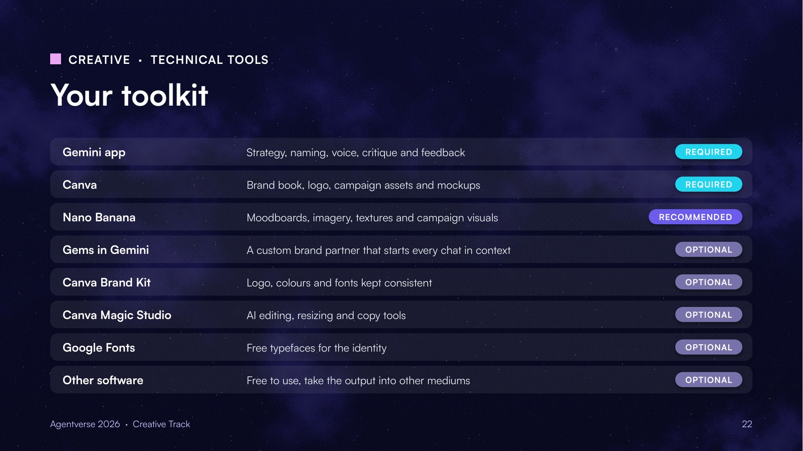
Notes:
Gemini app and Canva are required. Nano Banana is recommended. The rest are optional.

Slide 23
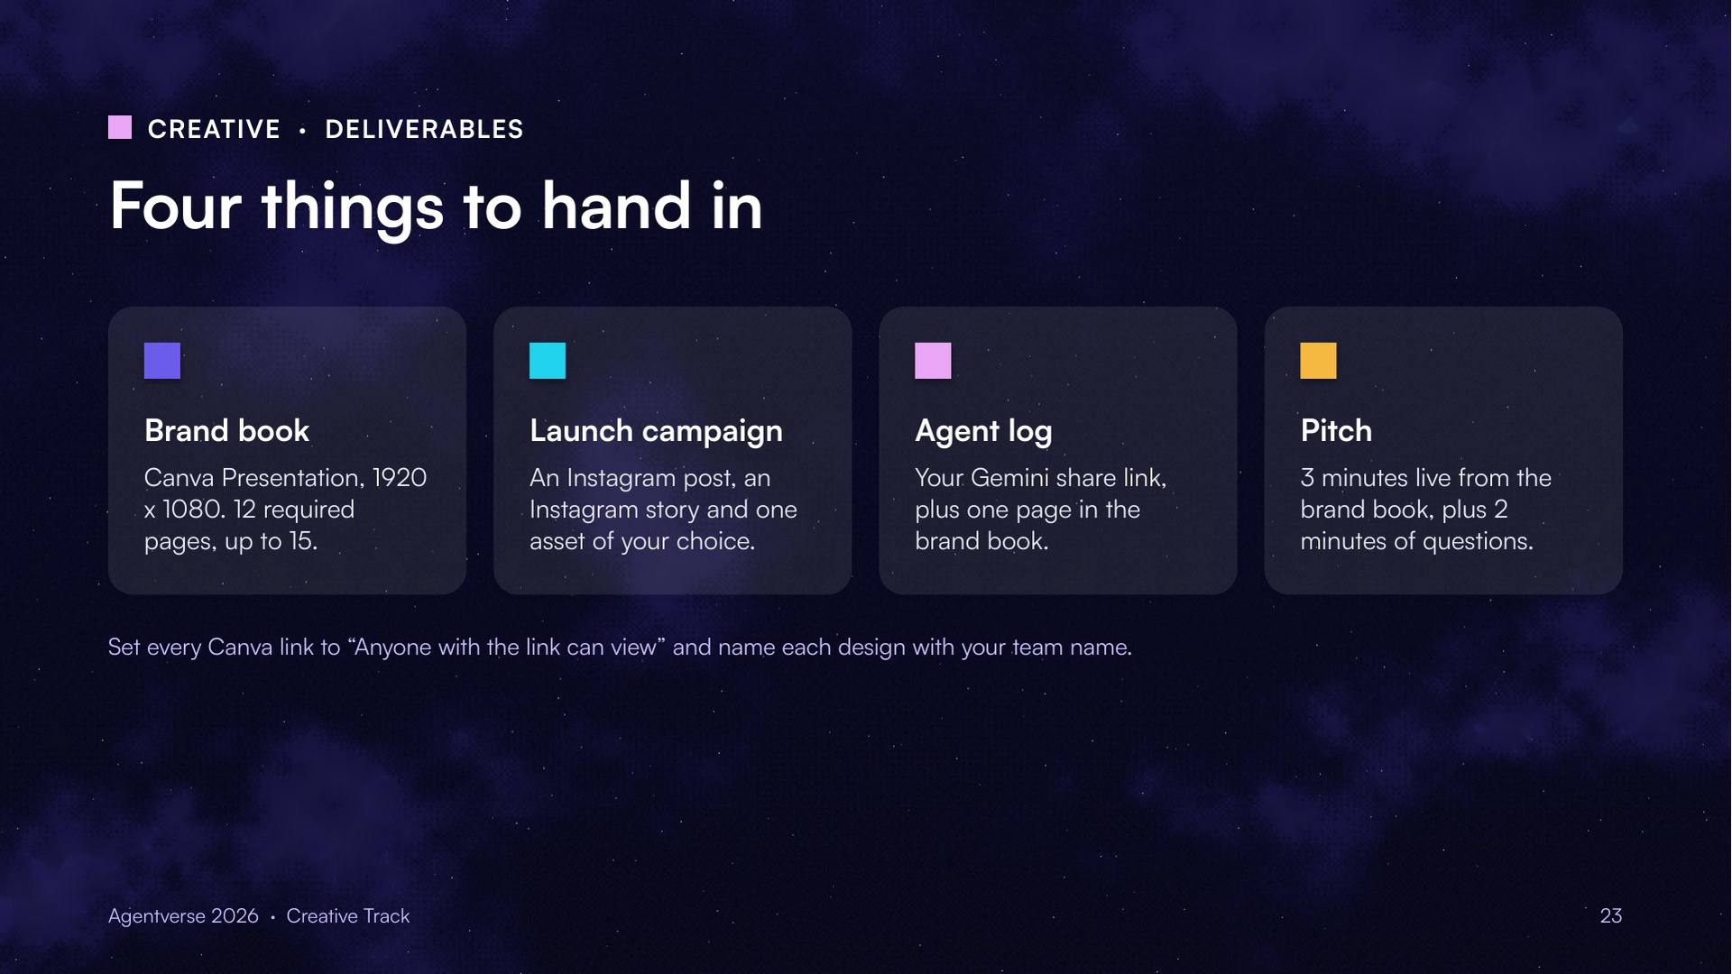
Notes:
Brand book, launch campaign, agent log and pitch.

Slide 24
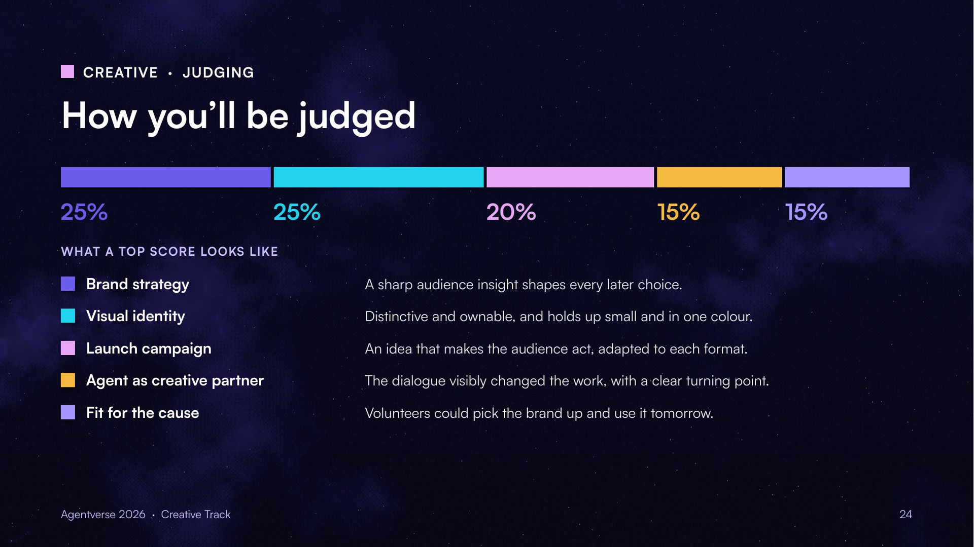
Notes:
Weights: 25, 25, 20, 15, 15.

Slide 25
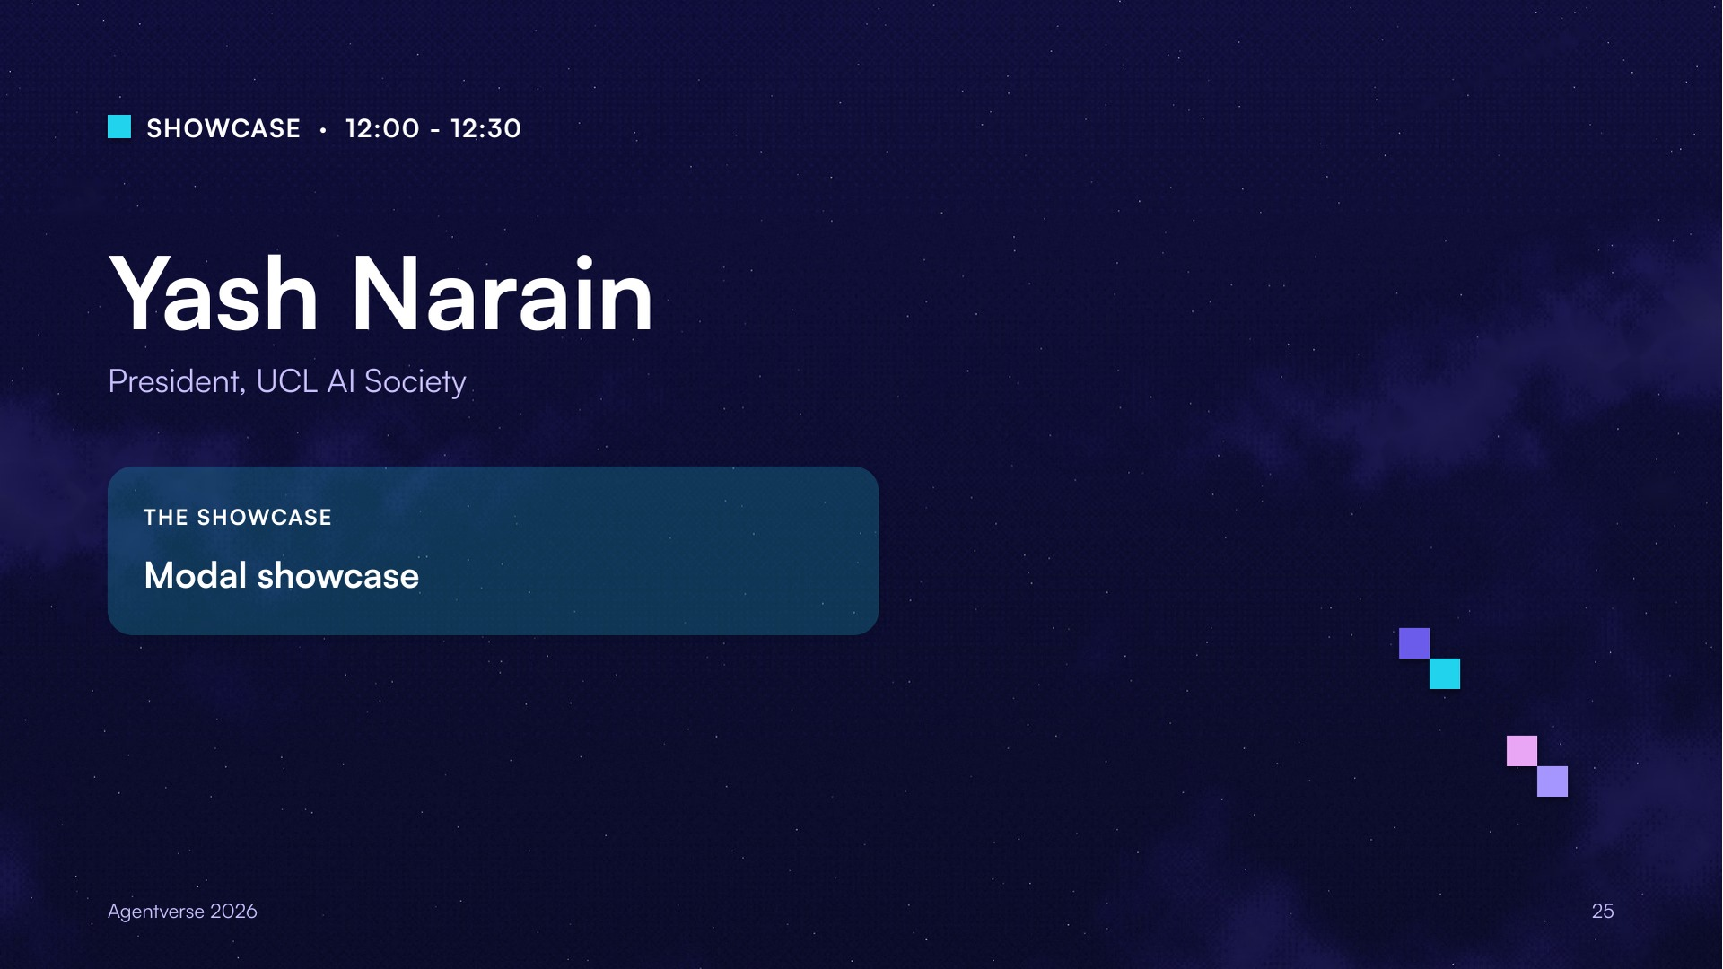
Notes:
Modal showcase, presented by Yash Narain, President of UCL AI Society.

Slide 26
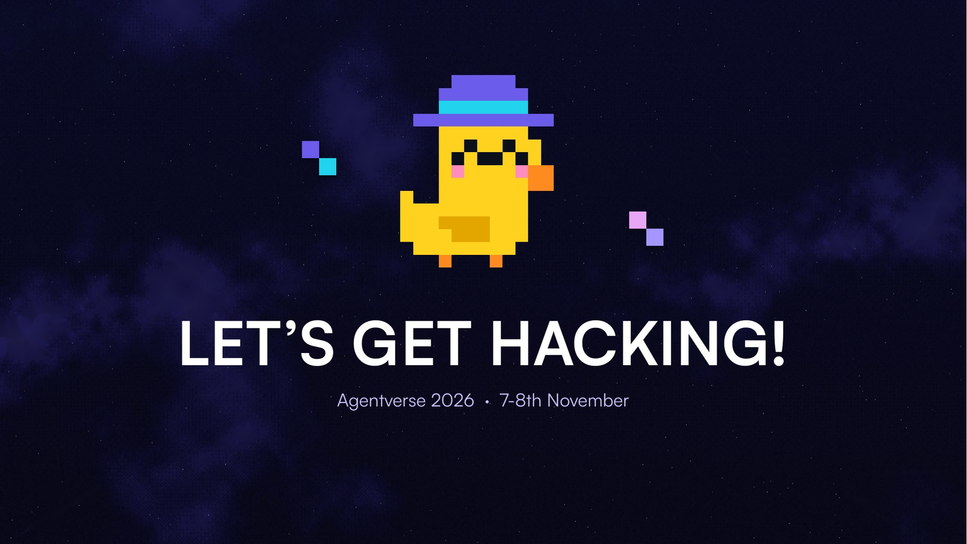
Notes:
Let's get hacking!

